Slide 1





Slide 2
STUDENT NAME : THIRUKALAI T
REGISTER NO & NMID : 24131190500122042
&
7BAA80E1E3DA632AACB44D36546A1ED3
Department : BCA
College Code : ANU119
College Name : Government Arts and Science College Tittagudi – 606106
University Name : Annamalai University

Slide 3
PROJECT TITLE
Digited Portfolio

Slide 4


AGENDA
Problem Statement
Project Overview
End Users
Tools and Technologies
Portfolio design and Layout
Features and Functionality
Results and Screenshots
Conclusion
Github Link

Slide 5

PROBLEM STATEMENT
Definition:
A digital portfolio is an online collection of work that showcases your skills, experiences, and accomplishments. It can include various media types such as text, images, videos, and links.

Slide 6

PROJECT OVERVIEW
Provide a centralized, accessible space for users to display their work.
Enhance the user’s professional presence and credibility.
Facilitate easy sharing with potential employers, clients, or educators.
Allow customization to reflect the user’s personal brand and style.

Slide 7
WHO ARE THE END USERS?
End users are the people who actually use a product, software, system, or service after it has been developed. They are the final recipients who interact with the product to fulfill their needs or tasks.
For example, in software development, end users are the individuals who operate the software in real-world scenarios, not the developers or testers.
Who Are the End Users - Digited Portfolio
Potential Employers or Recruiters
Clients
Educators or Admissions Committees
The Portfolio Owner

Slide 8

TOOLS AND TECHNIQUES
TOOLS | Example
Website Builders | WordPress
Design and Multimedia Tools | Canva, Adobe Photoshop
Code Editors | Visual Studio Code
Version Control | Git and GitHub
Hosting Platforms | Hosting Platforms
:

Slide 9
TOOLS AND TECHNIQUES
TECHNIQUES | Example
Responsive Design | Desktops, Tablets, Smartphones
User Experience (UX) Design | Designing intuitive navigation, clear structure, and easy access to content to enhance visitor engagement.
Regular Updates | Keeping the portfolio current by adding new projects, achievements, and removing outdated content.

Slide 10
POTFOLIO DESIGN AND LAYOUT
1. Choose a Clean and Professional Design
2. Typography
3. Layout Structure
4. Navigation
5. Project Presentation
6. Visual Elements
7. Responsive Design
8. Call to Action (CTA)
9. Testimonials and Endorsements
10. Regular Updates
10

Slide 11
FEATURES AND FUNCTIONALITY
1.Responsive Design
2.User -Friendly Navigation
3.Project Showcase
4.Search Functionality
5.Contact Form
6.Social Media Integration
7.Downloadable Resume
8.Testimonials and Endorsements

Slide 12
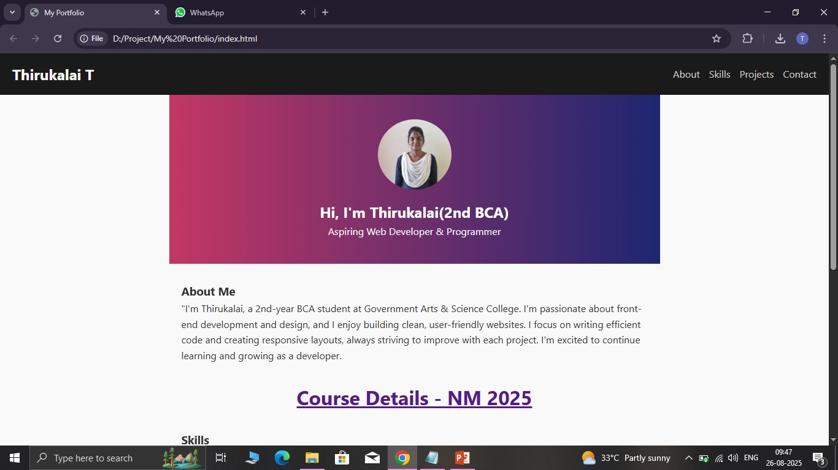

RESULTS AND SCREENSHOTS
12

Slide 13
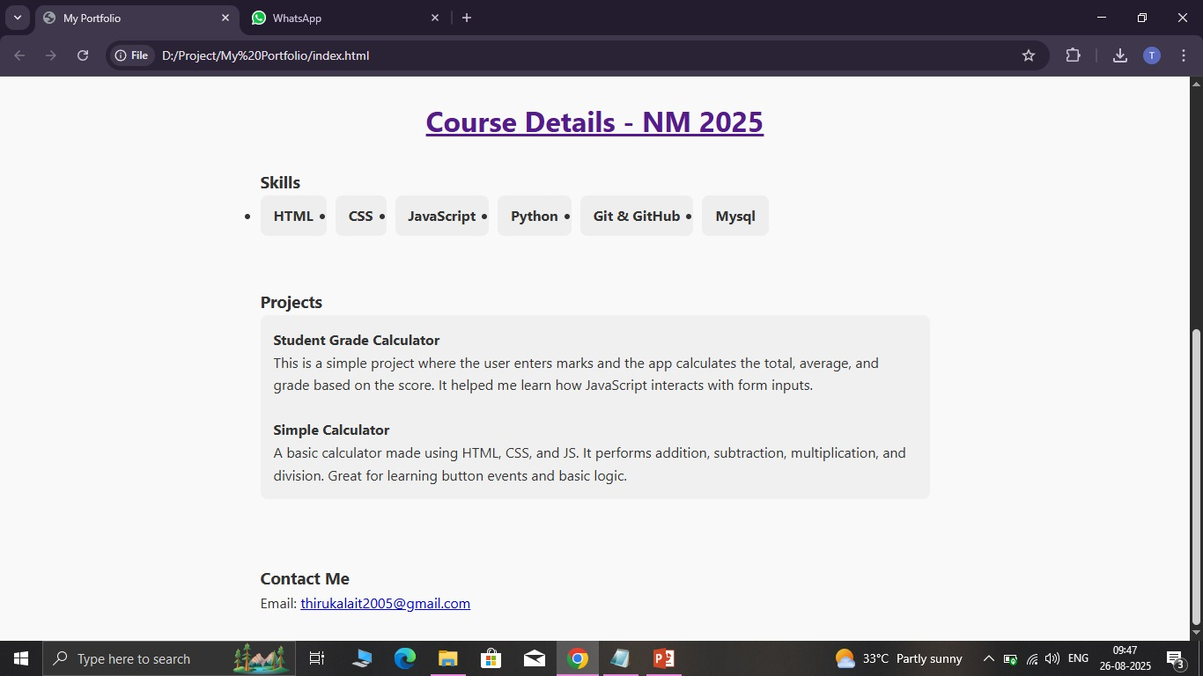
RESULTS AND SCREENSHOTS
13

Slide 14
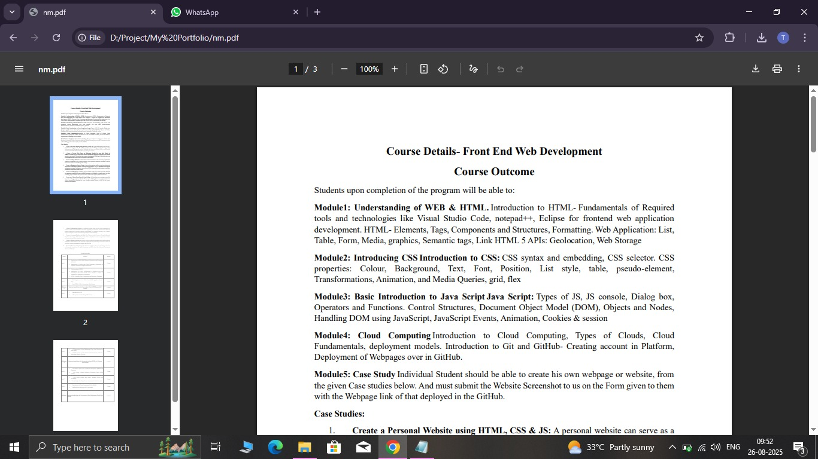
RESULTS AND SCREENSHOTS
14

Slide 15
CONCLUSION
Creating a digital portfolio is an essential step for professionals and creatives looking to showcase their skills, experiences, and projects in a compelling way. A well-designed portfolio not only highlights your work but also serves as a powerful tool for personal branding and networking. Here are some key takeaways for concluding your digital portfolio:
15

Slide 16
Github Link
https://github.com/THIRUKALAIT/Thirukalait-TNSDC-FWD-DP.git

Slide 17
Thanks to All

